Slide 1


Carer Support
The role of InsideOut
Danielle Maloney
Deputy Director
Head of Service Development and Policy

Slide 2

Our Four Pillars
1. Research
2. Clinical innovation
3. Education
4. Public policy
Notes:
FOUR PILLARS
A four-pillar approach lies at the core of all of Inside Out’s activities:
Research
Support the best research in eating disorders across Australia. Conduct, translate and disseminate research evidence and innovation into the daily practice of front-line clinicians.
For example (ambitious research agenda):
Oxytocin study
We are leading the research into men and eating disorders (is that true?)
Applications in real life treatment settings
Pursuit of breakthroughs
Our board members are recognised as world leaders in the field
Textbooks and publications
Our team asked to speak at international conferences
Clinical Innovation
Make available to every person with an eating disorder and their carers, early diagnosis, guidance through the health system, and equitable access to evidence-based treatment packages.
For eample:
Programs for: Front line clinicians, Inpatient management, etc
World’s first eLearning and eTherapy centre for eating disorders
Binge Eating eTherapy program is among several new programs in the works – eTherapy is the way of the future!
Nine beds housed in a cutting-edge long-stay hospital unit for critically ill patients (in Sydney)
Multiple day programs in hospitals and communities across NSW
We are pioneers, on the front foot of changing technologies
Inside Out has listened to the needs of ED patients and their families. Young people are dying unnecessarily, and cannot access the health system. Beyond CHANGE to the system, what they have told us they need is help NAVIGATING the system. As you well know the health system is a mammoth with many splintered parts that often have NO communication lines, and in most cases there is no ‘one-stop-shop’ or even ‘first port of call’ to guide the person and their family through a successful treatment journey. This had devastating consequences, people fail to receive treatments that exists, or treatment at all, and die in unacceptable numbers.
Over the last four years we lead the project of major health system change for eating disorders across NSW. Patients were being turned away from hospitals, unable to access care in rural and remote centres and unable to get evidence based treatment in community mental health teams. So we rebuilt the system.
We built two tertiary expert hubs one for C&A at Westmead, one for Adults at RPA, Camperdown, we got two specialist outreach teams funded at those hubs to outreach to rural and remote clinicians and teams to train and support them into treating patients, we got 17 eating disorder coordinator positions funded in NSW, one in each district and built a network linking them to the hubs and outreach teams
Education
Make the issue of eating disorders an everyday conversation, for everybody. Driven by the principles of knowledge translation, we will train the workforce in the most current evidence-based practice.
Public Policy
Provide coherent and integrated public policy to address the treatment of eating disorders in all relevant sectors and all states and territories nation-wide.
Inspired public policy:
Our NSW Service Plan has transformed the delivery of eating disorder care across the state
Sufferers can get the help they need no matter where they live in the state
Guidelines for personal trainers and fitness instructors
Consulted by the highest levels of Government on Mental Health Agenda

Slide 3
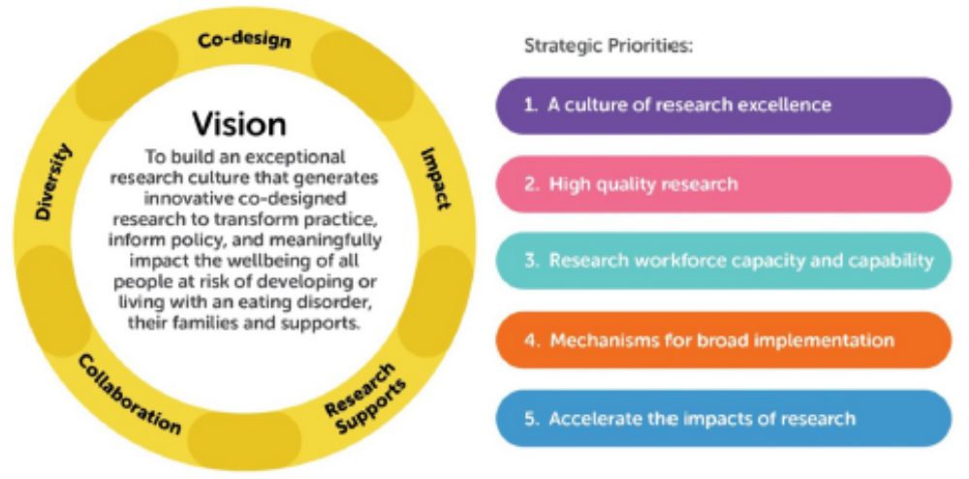
Australian Eating Disorders Research & Translation Strategy 2021-2031

Slide 4
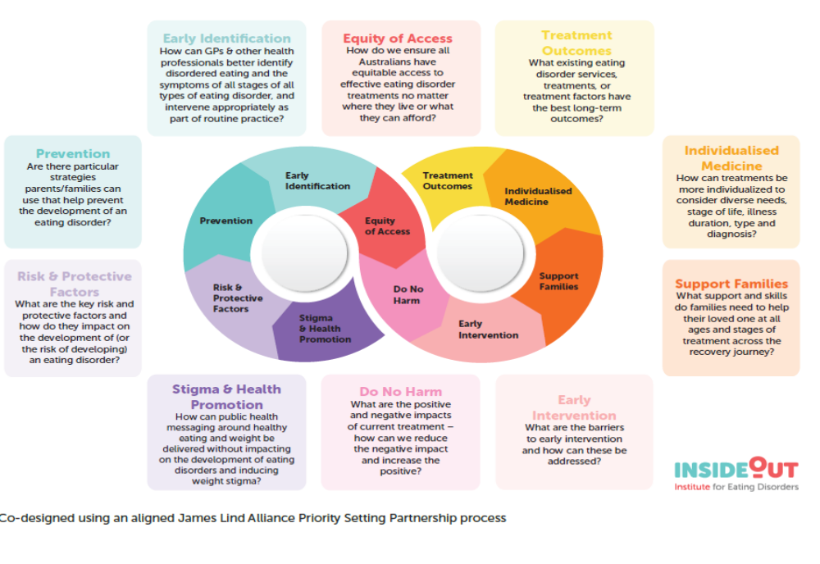

Slide 5

The Challenge
To get effective evidence based treatments to people early in the illness and bring about total remission
While……
Developing prevention programs that work
Developing alternate treatments for those for whom the first-line therapy does not work

Slide 6
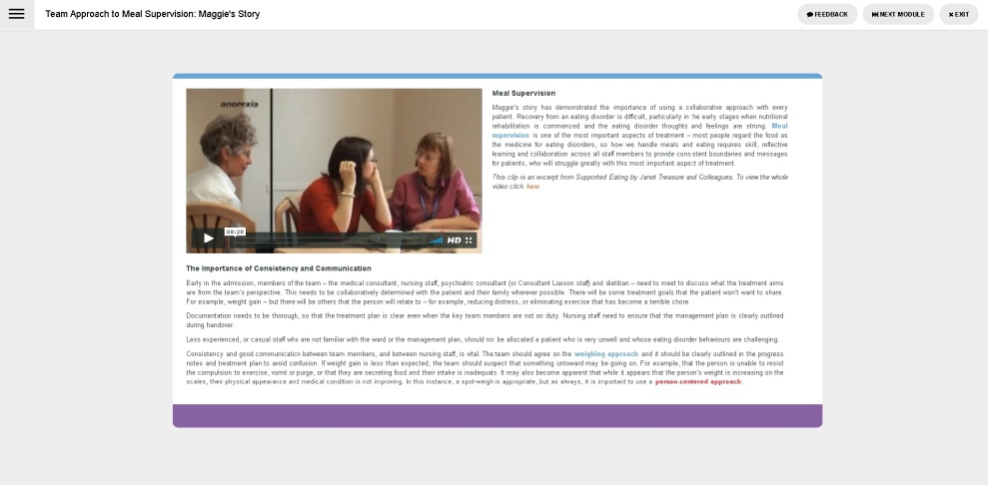
eLearning
12 online modules available, including introductory, inpatient management, meal support, specific Dietitians, carers skill base package, school package.
Of the 7,500 places funded by the Federal government for the Essentials program 6855 have currently been utilised (645 remaining):
4835 have completed introductory level content
3763 have completed content to the level set by industry organisations as pre-requisite knowledge for therapy-specific training
3402 have completed comprehensive level content
We are developing knowledge and growing the workforce:
  Nearly 60% of completers are novice practitioners who have no previous experience working with people who have eating disorders (about 40%), or just 1-2 years experience (about 20%)

Slide 7
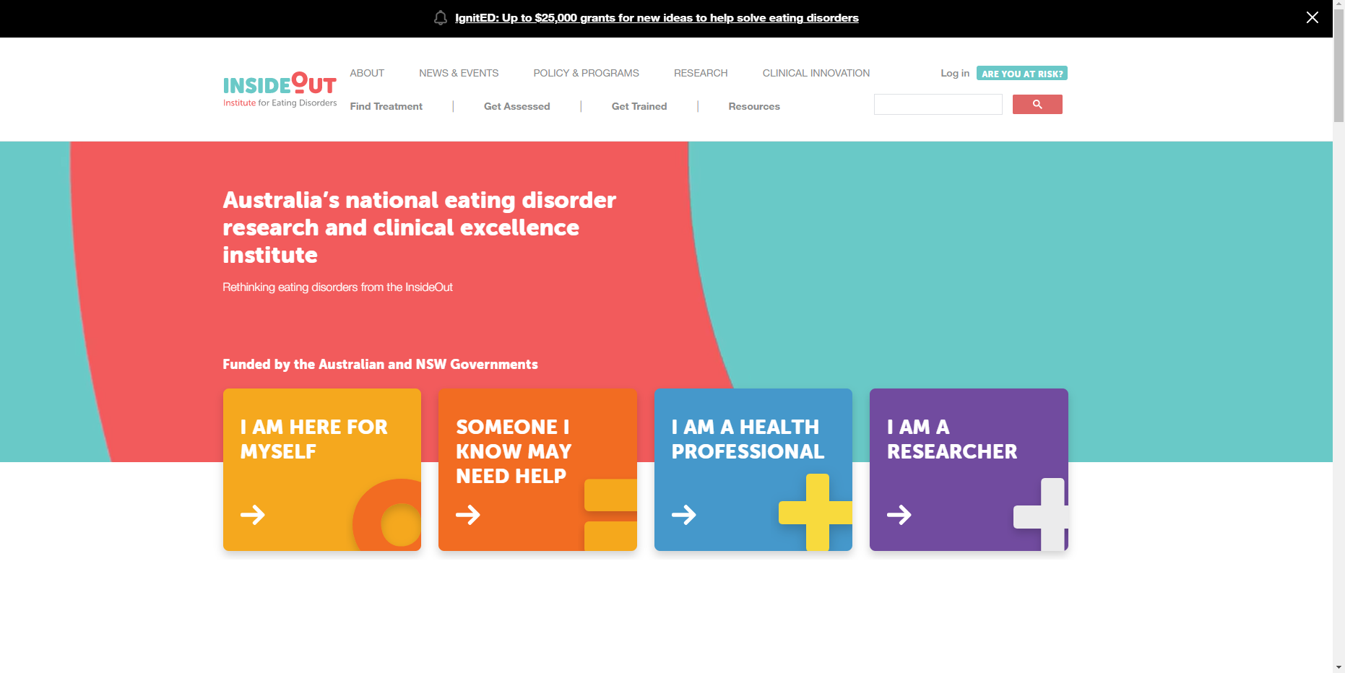
Resources for Carers

Slide 8
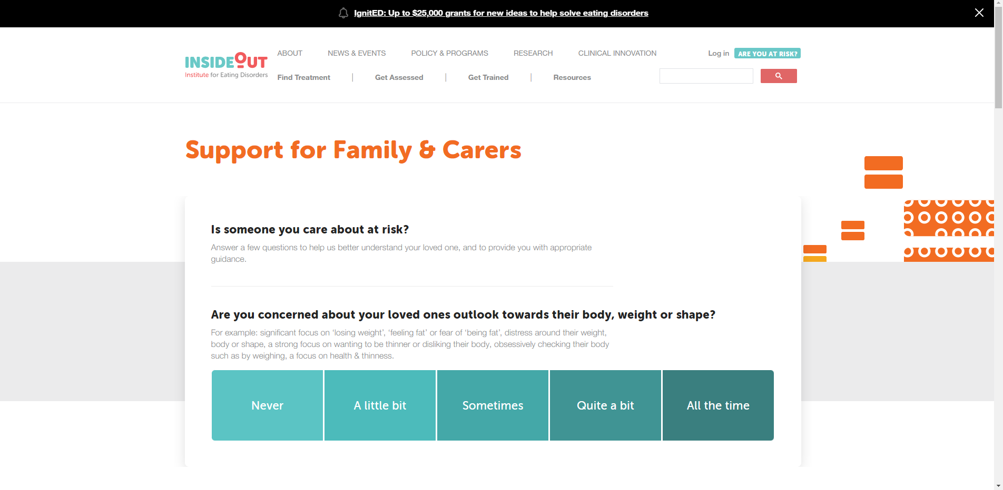

Slide 9
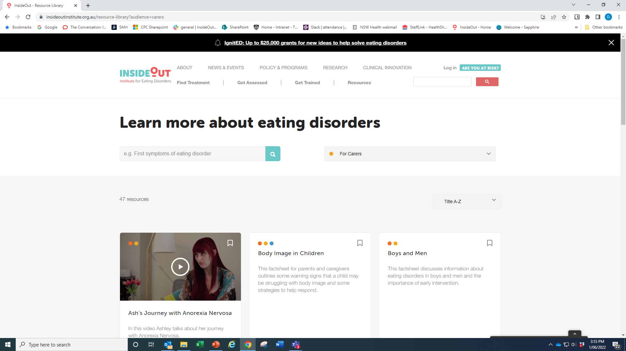

Slide 10
SupportED
An online program for those who support someone with an Eating Disorder
Rachel Simeone – Senior Project Manager, InsideOut Institute
Dr Sarah Maguire – Director, InsideOut Institute
Dr Jane Miskovic-Wheatley - Research Stream Lead, InsideOut Institute
Dr Genevieve Pepin – Deakin University
Eyza Koresche - Research Officer, InsideOut Institute
Jasmin Schlage – Masters of Psychology student
Bronny Carrol – Carer Consultant, InsideOut Insitute
Eating Disorders Families Australia

Slide 11
Why support people?
Support people play a key role in identifying symptoms, encouraging treatment and providing care and support throughout recovery
Having good support can result in decreased severity and length of illness for the person with the eating disorder.
Eating disorders impact and place significant burden on family and carers and due to chronicity caring role is often protracted.
Inclusion of carers in treatment is a well recognised gap
Notes:
NICE guidelines stress the importance of including family/carers in evidenced based treatment for children and for adults.
Chronicity
Challenges faced by carers:
Isolation
Burnout
Strain on relationships

Slide 12

Why an online program?
Targeted educational and practical skill based programs have been found to improve coping, knowledge, communication and overall skills resulting in reduced stress and burden.
Previous programs have been small and niche and at present there are no routinely available programs online or face-to-face in Australia.
There is a need for an easily accessible, knowledge and skills based program which also serves to support the navigation of currently available resources and provides practical advice to carers.
Notes:
Carer programs have typically been targeted at parents of children with AN – a broader scope is required
Support programs effective to reduce isolation - targeted education and practical skills reduce distress and burden further.

Slide 13
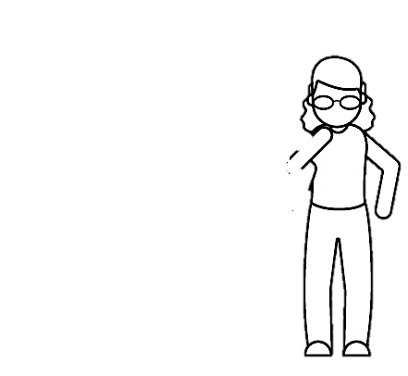
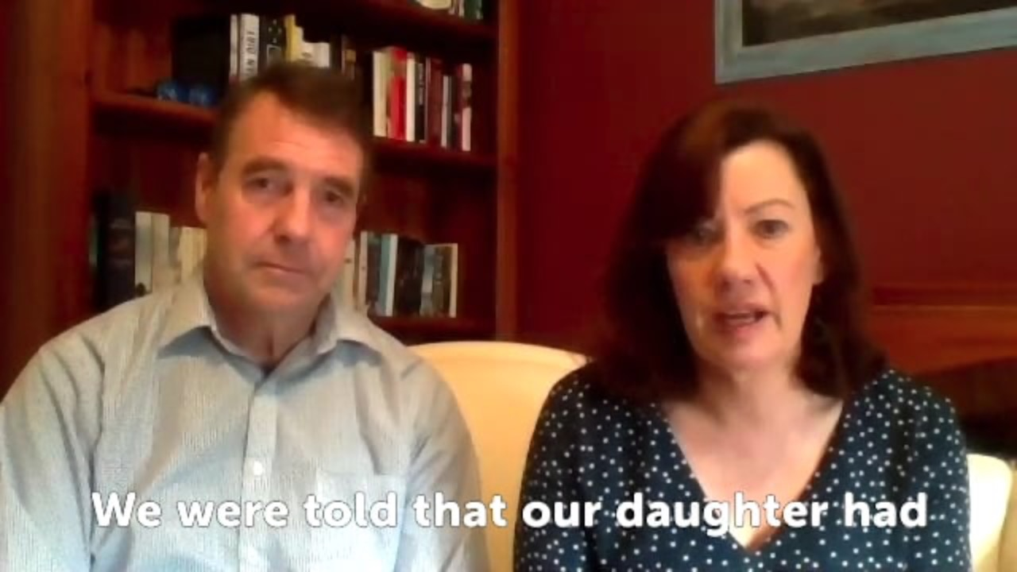
For carers from carers
Notes:
https://vimeo.com/519710759

Slide 14






Five Modules
Learning about Eating Disorders
  Noticing and responding to warning signs
  Treatment options and engagement
Additional Strategies
Managing co-occurring medical and mental health conditions
Medical and self-harm risk management
Navigating inpatient admissions
Financial support options
Communication Skills
  Talking to your loved one
  Talking to health professionals
  Motivation, externalisation and getting your needs met
Recovery and Beyond
Responding to lapses/relapses
Finding meaning and purpose
Stepping back from the carer role
Practical Skills
Responding to specific symptoms
Strategies for meal times
Conflict resolution and boundary setting
Notes:
https://vimeo.com/519710759

Slide 15
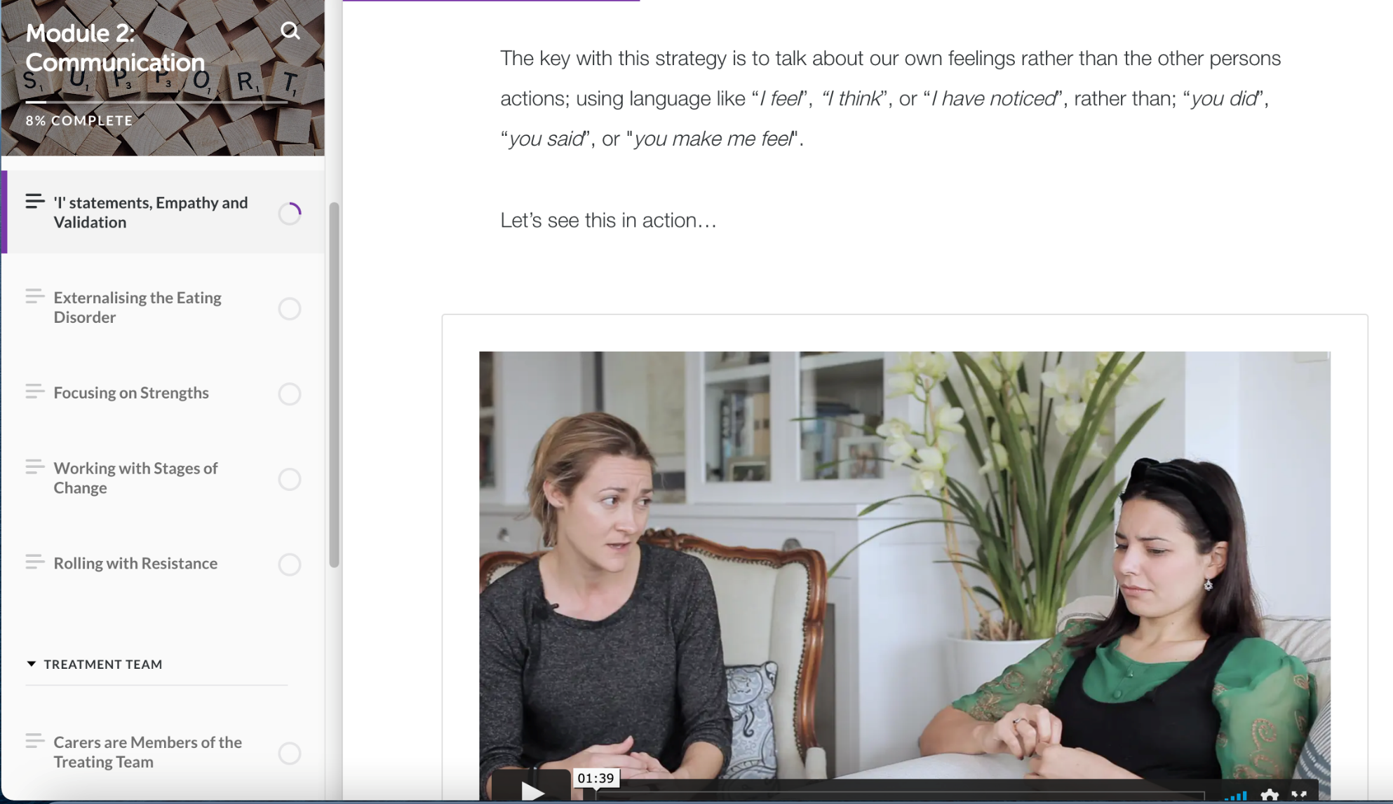


Slide 16

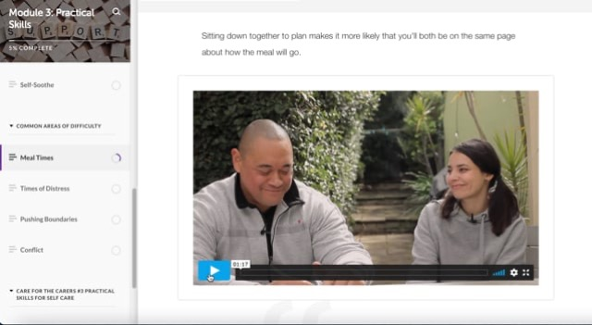
https://vimeo.com/522546503
Notes:
<iframe src="https://player.vimeo.com/video/522546503" width="640" height="351" frameborder="0" allow="autoplay; fullscreen; picture-in-picture" allowfullscreen></iframe>

Slide 17




https://insideoutinstitute.org.au/

